Slide 1
Style Transfer Implement
崔耘珩

Slide 2
Outline
Fei-Fei Li’s Model
Introduction
Build Environment
Code
Model
Introduction
Build Environment
Train
Evaluation
Examples

Slide 3
Fei-Fei Li’s Model
Perceptual Losses for Real-Time Style Transfer and Super-Resolution

Slide 4
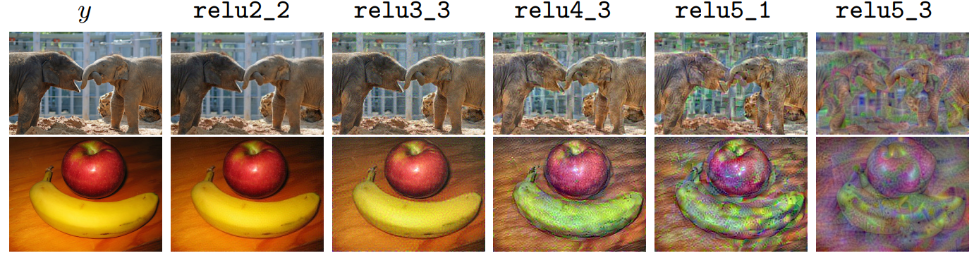
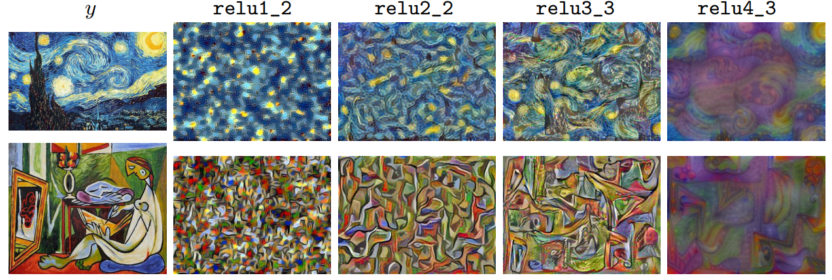
Introduction (Train)
Content Loss
Style Loss
Source: https://arxiv.org/pdf/1603.08155.pdf

Slide 5
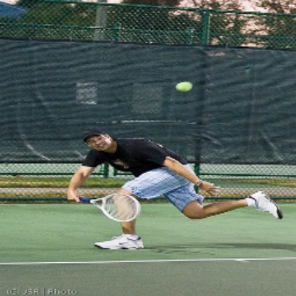
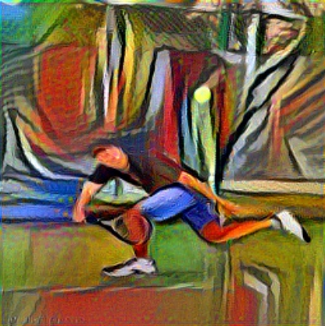
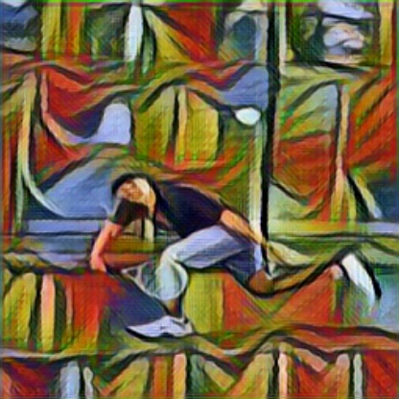
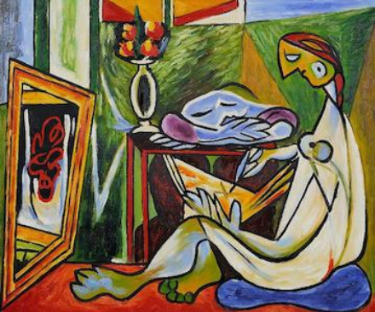
Introduction (Evaluation)
Perceptual Loss
Content
Per-pixel Loss
Perceptual Loss
Style
Gatys et al. (2015)
Fei-Fei Li (2016)
Source: https://arxiv.org/pdf/1603.08155.pdf

Slide 6
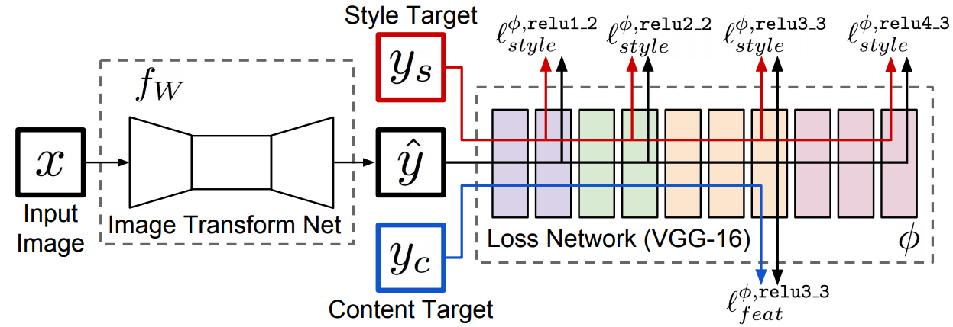
Introduction (Evaluation)
Source: https://arxiv.org/pdf/1603.08155.pdf

Slide 7
Build Environment
Python Version: 3.7.11
Clone files from the Github repository.
git clone https://github.com/pytorch/examples.git
Change directory to examples/fast_neural_style/
cd examples/fast_neural_style/

Slide 8
Build Environment
Install requirements.
pip install –r requirements.txt
requirements.txt
torchvision @ https://download.pytorch.org/whl/cu102/torchvision-0.10.0%2Bcu102-cp37-cp37m-linux_x86_64.whl torch @ https://download.pytorch.org/whl/cu102/torch-1.9.0%2Bcu102-cp37-cp37m-linux_x86_64.whl tensorflow @ file:///tensorflow-2.5.0-cp37-cp37m-linux_x86_64.whl tensorboard==2.5.0 keras==2.4.3 scipy==1.4.1 numpy==1.19.5

Slide 9
Build Environment
Create dataset folder.
mkdir dataset
Download dataset. (COCO 2014 Training images dataset)
curl -O http://images.cocodataset.org/zips/train2014.zip
Unzip dataset
unzip train2014.zip –d dataset

Slide 10
Build Environment
Train the model.
python3 neural_style/neural_style.py train --dataset </path/to/train-dataset> \ --style-image </path/to/style/image> \ --save-model-dir </path/to/save-model/folder> \ --checkpoint-model-dir </path/to/save-model/folder> \ --checkpoint-interval 500 \ --content-weight 10e4 \ --epochs 2 \ --cuda 1
--dataset: Path to training dataset.
--style-image: Path to style-image.
--save-model-dir: Path to save the trained model.
--checkpoint-model-dir: Path to save the checkpoints.
--checkpoint-interval: Number of batches after which a checkpoint of the trained model will be created.
--content-weight: Weight for content-loss.
--epochs: Number of training epochs.
--cuda: Set it to 1 for running on GPU, 0 for CPU.

Slide 11
Build Environment
Evaluate the model.
python3 neural_style/neural_style.py eval --content-image </path/to/content/image> \ --model </path/to/saved/model> \ --output-image </path/to/output/image> \ --cuda 0
--content-image: Path to content images.
--model: Saved models or checkpoints to be used for stylizing the image.
--output-image: Path for saving the output image.
--cuda: Set it to 1 for running on GPU, 0 for CPU.

Slide 12
Code
Import modules.
neural_style.py
import argparse import os import sys import time import re import numpy as np import torch from torch.optim import Adam from torch.utils.data import DataLoader from torchvision import datasets from torchvision import transforms import torch.onnx import utils from transformer_net import TransformerNet from vgg import Vgg16

Slide 13
Code (Cont’d)
Check paths function.
def check_paths(args): try: if not os.path.exists(args.save_model_dir): os.makedirs(args.save_model_dir) if args.checkpoint_model_dir is not None and not (os.path.exists(args.checkpoint_model_dir)): os.makedirs(args.checkpoint_model_dir) except OSError as e: print(e) sys.exit(1)

Slide 14
Code (Cont’d)
Function of training model. (1/8)
def train(args): # Use CUDA or CPU to train the model. device = torch.device("cuda" if args.cuda else "cpu") # Set random seed. np.random.seed(args.seed) torch.manual_seed(args.seed) transform = transforms.Compose([ # Resize and crop image. transforms.Resize(args.image_size), transforms.CenterCrop(args.image_size), # Change the image representation from array to float32. transforms.ToTensor(), transforms.Lambda(lambda x: x.mul(255)) ])

Slide 15
Code (Cont’d)
Function of training model. (2/8)
# Load train dataset. train_dataset = datasets.ImageFolder(args.dataset, transform) train_loader = DataLoader(train_dataset, batch_size=args.batch_size) # Import Transform Network. transformer = TransformerNet().to(device) # Import loss function. optimizer = Adam(transformer.parameters(), args.lr) mse_loss = torch.nn.MSELoss() # Use VGG16 architecture as Loss Network. vgg = Vgg16(requires_grad=False).to(device) style_transform = transforms.Compose([ transforms.ToTensor(), transforms.Lambda(lambda x: x.mul(255)) ])

Slide 16
Code (Cont’d)
Function of training model. (3/8)
# Import the style image. style = utils.load_image(args.style_image, size=args.style_size) # Transfer feature of style image. style = style_transform(style) style = style.repeat(args.batch_size, 1, 1, 1).to(device) # Calculate style loss of style image. features_style = vgg(utils.normalize_batch(style)) gram_style = [utils.gram_matrix(y) for y in features_style]

Slide 17
Code (Cont’d)
Function of training model. (4/8)
# Training for optimize model. for e in range(args.epochs): transformer.train() agg_content_loss = 0. agg_style_loss = 0. count = 0

Slide 18
Code (Cont’d)
Function of training model. (5/8)
# Extract features from content image. for batch_id, (x, _) in enumerate(train_loader): n_batch = len(x) count += n_batch optimizer.zero_grad() # Construct a network on CPU or GPU. x = x.to(device) y = transformer(x) # Normalize layer. y = utils.normalize_batch(y) x = utils.normalize_batch(x) # Extract image features. features_y = vgg(y) features_x = vgg(x) # Calculate content loss and content weight of content image. content_loss = args.content_weight * mse_loss(features_y.relu2_2, features_x.relu2_2) style_loss = 0.

Slide 19
Code (Cont’d)
Function of training model. (6/8)
# Training for optimize model. for ft_y, gm_s in zip(features_y, gram_style): gm_y = utils.gram_matrix(ft_y) style_loss += mse_loss(gm_y, gm_s[:n_batch, :, :]) style_loss *= args.style_weight total_loss = content_loss + style_loss total_loss.backward() optimizer.step() agg_content_loss += content_loss.item() agg_style_loss += style_loss.item()

Slide 20
Code (Cont’d)
Function of training model. (7/8)
if (batch_id + 1) % args.log_interval == 0: mesg = "{}\tEpoch {}:\t[{}/{}]\tcontent: {:.6f}\tstyle: {:.6f}\ttotal: {:.6f}".format( time.ctime(), e + 1, count, len(train_dataset), agg_content_loss / (batch_id + 1), agg_style_loss / (batch_id + 1), (agg_content_loss + agg_style_loss) / (batch_id + 1) ) print(mesg)
if args.checkpoint_model_dir is not None and (batch_id + 1) % args.checkpoint_interval == 0: transformer.eval().cpu() ckpt_model_filename = "ckpt_epoch_" + str(e) + "_batch_id_" + str(batch_id + 1) + ".pth" ckpt_model_path = os.path.join(args.checkpoint_model_dir, ckpt_model_filename) torch.save(transformer.state_dict(), ckpt_model_path) transformer.to(device).train()

Slide 21
Code (Cont’d)
Function of training model. (8/8)
# Save model. transformer.eval().cpu() save_model_filename = "epoch_" + str(args.epochs) + "_" + str(time.ctime()).replace(' ', '_') + "_" + str( args.content_weight) + "_" + str(args.style_weight) + ".model" save_model_path = os.path.join(args.save_model_dir, save_model_filename) torch.save(transformer.state_dict(), save_model_path) print("\nDone, trained model saved at", save_model_path)

Slide 22
Code (Cont’d)
Function of stylize image.
def stylize(args): # Use CUDA or CPU to stylize the image. device = torch.device("cuda" if args.cuda else "cpu") # Import the content image. content_image = utils.load_image(args.content_image, scale=args.content_scale) content_transform = transforms.Compose([ transforms.ToTensor(), transforms.Lambda(lambda x: x.mul(255)) ]) # Load the content image to the Network. content_image = content_transform(content_image) content_image = content_image.unsqueeze(0).to(device)

Slide 23
Code (Cont’d)
Argument Parsers. (1/4)
def main(): main_arg_parser = argparse.ArgumentParser(description="parser for fast-neural-style") subparsers = main_arg_parser.add_subparsers(title="subcommands", dest="subcommand") train_arg_parser = subparsers.add_parser("train", help="parser for training arguments") train_arg_parser.add_argument("--epochs", type=int, default=2, help="number of training epochs, default is 2") train_arg_parser.add_argument("--batch-size", type=int, default=4, help="batch size for training, default is 4") train_arg_parser.add_argument("--dataset", type=str, required=True, help="path to training dataset, the path should point to a folder " "containing another folder with all the training images") train_arg_parser.add_argument("--style-image", type=str, default="images/style-images/mosaic.jpg", help="path to style-image") train_arg_parser.add_argument("--save-model-dir", type=str, required=True, help="path to folder where trained model will be saved.") train_arg_parser.add_argument("--checkpoint-model-dir", type=str, default=None, help="path to folder where checkpoints of trained models will be saved")

Slide 24
Code (Cont’d)
Argument Parsers. (2/4)
train_arg_parser.add_argument("--image-size", type=int, default=256, help="size of training images, default is 256 X 256") train_arg_parser.add_argument("--style-size", type=int, default=None, help="size of style-image, default is the original size of style image") train_arg_parser.add_argument("--cuda", type=int, required=True, help="set it to 1 for running on GPU, 0 for CPU") train_arg_parser.add_argument("--seed", type=int, default=42, help="random seed for training") train_arg_parser.add_argument("--content-weight", type=float, default=1e5, help="weight for content-loss, default is 1e5") train_arg_parser.add_argument("--style-weight", type=float, default=1e10, help="weight for style-loss, default is 1e10") train_arg_parser.add_argument("--lr", type=float, default=1e-3, help="learning rate, default is 1e-3") train_arg_parser.add_argument("--log-interval", type=int, default=500, help="number of images after which the training loss is logged, default is 500") train_arg_parser.add_argument("--checkpoint-interval", type=int, default=2000, help="number of batches after which a checkpoint of the trained model will be created")

Slide 25
Code (Cont’d)
Argument Parsers. (3/4)
eval_arg_parser = subparsers.add_parser("eval", help="parser for evaluation/stylizing arguments") eval_arg_parser.add_argument("--content-image", type=str, required=True, help="path to content image you want to stylize") eval_arg_parser.add_argument("--content-scale", type=float, default=None, help="factor for scaling down the content image") eval_arg_parser.add_argument("--output-image", type=str, required=True, help="path for saving the output image") eval_arg_parser.add_argument("--model", type=str, required=True, help="saved model to be used for stylizing the image. If file ends in .pth - PyTorch path is used, if in .onnx - Caffe2 path") eval_arg_parser.add_argument("--cuda", type=int, required=True, help="set it to 1 for running on GPU, 0 for CPU") eval_arg_parser.add_argument("--export_onnx", type=str, help="export ONNX model to a given file")

Slide 26
Code (Cont’d)
Argument Parsers. (4/4)
args = main_arg_parser.parse_args() if args.subcommand is None: print("ERROR: specify either train or eval") sys.exit(1) if args.cuda and not torch.cuda.is_available(): print("ERROR: cuda is not available, try running on CPU") sys.exit(1) if args.subcommand == "train": check_paths(args) train(args) else: stylize(args) if __name__ == "__main__": main()

Slide 27
Code (Cont’d)
VGG16 architecture. (1/2)
vgg.py
from collections import namedtuple import torch from torchvision import models class Vgg16(torch.nn.Module): def __init__(self, requires_grad=False): super(Vgg16, self).__init__() vgg_pretrained_features = models.vgg16(pretrained=True).features # Build sequential modules. self.slice1 = torch.nn.Sequential() self.slice2 = torch.nn.Sequential() self.slice3 = torch.nn.Sequential() self.slice4 = torch.nn.Sequential() for x in range(4): self.slice1.add_module(str(x), vgg_pretrained_features[x]) for x in range(4, 9): self.slice2.add_module(str(x), vgg_pretrained_features[x]) for x in range(9, 16): self.slice3.add_module(str(x), vgg_pretrained_features[x]) for x in range(16, 23): self.slice4.add_module(str(x), vgg_pretrained_features[x]) if not requires_grad: for param in self.parameters(): param.requires_grad = False

Slide 28
Code (Cont’d)
VGG16 architecture. (2/2)
vgg.py
def forward(self, X): h = self.slice1(X) h_relu1_2 = h h = self.slice2(h) h_relu2_2 = h h = self.slice3(h) h_relu3_3 = h h = self.slice4(h) h_relu4_3 = h vgg_outputs = namedtuple("VggOutputs", ['relu1_2', 'relu2_2', 'relu3_3', 'relu4_3']) out = vgg_outputs(h_relu1_2, h_relu2_2, h_relu3_3, h_relu4_3) return out

Slide 29
Code (Cont’d)
utils.py (1/2)
import torch from PIL import Image # Function of load image. def load_image(filename, size=None, scale=None): img = Image.open(filename).convert('RGB') if size is not None: img = img.resize((size, size), Image.ANTIALIAS) elif scale is not None: img = img.resize((int(img.size[0] / scale), int(img.size[1] / scale)), Image.ANTIALIAS) return img # Function of save image. def save_image(filename, data): img = data.clone().clamp(0, 255).numpy() img = img.transpose(1, 2, 0).astype("uint8") img = Image.fromarray(img) img.save(filename)

Slide 30
Code (Cont’d)
utils.py (2/2)
# Gram matrix function. def gram_matrix(y): (b, ch, h, w) = y.size() features = y.view(b, ch, w * h) features_t = features.transpose(1, 2) gram = features.bmm(features_t) / (ch * h * w) return gram def normalize_batch(batch): # Normalize using imagenet mean and std. mean = batch.new_tensor([0.485, 0.456, 0.406]).view(-1, 1, 1) std = batch.new_tensor([0.229, 0.224, 0.225]).view(-1, 1, 1) batch = batch.div_(255.0) return (batch - mean) / std

Slide 31
Code (Cont’d)
Image Transform Network. (1/5)
transformer_net.py
import torch # Define style transfer network. class TransformerNet(torch.nn.Module): def __init__(self): super(TransformerNet, self).__init__() # Initial convolution layers. self.conv1 = ConvLayer(3, 32, kernel_size=9, stride=1) self.in1 = torch.nn.InstanceNorm2d(32, affine=True) self.conv2 = ConvLayer(32, 64, kernel_size=3, stride=2) self.in2 = torch.nn.InstanceNorm2d(64, affine=True) self.conv3 = ConvLayer(64, 128, kernel_size=3, stride=2) self.in3 = torch.nn.InstanceNorm2d(128, affine=True) # Build residual layers. self.res1 = ResidualBlock(128) self.res2 = ResidualBlock(128) self.res3 = ResidualBlock(128) self.res4 = ResidualBlock(128) self.res5 = ResidualBlock(128)

Slide 32
Code (Cont’d)
Image Transform Network. (2/5)
transformer_net.py
# Build upsampling layers. self.deconv1 = UpsampleConvLayer(128, 64, kernel_size=3, stride=1, upsample=2) self.in4 = torch.nn.InstanceNorm2d(64, affine=True) self.deconv2 = UpsampleConvLayer(64, 32, kernel_size=3, stride=1, upsample=2) self.in5 = torch.nn.InstanceNorm2d(32, affine=True) self.deconv3 = ConvLayer(32, 3, kernel_size=9, stride=1) # Use Rectified Linear Unit (ReLU) for activation function. self.relu = torch.nn.ReLU() # Define forward propagation network. def forward(self, X): y = self.relu(self.in1(self.conv1(X))) y = self.relu(self.in2(self.conv2(y))) y = self.relu(self.in3(self.conv3(y))) y = self.res1(y) y = self.res2(y) y = self.res3(y) y = self.res4(y) y = self.res5(y) y = self.relu(self.in4(self.deconv1(y))) y = self.relu(self.in5(self.deconv2(y))) y = self.deconv3(y) return y
# Build upsampling layers. self.deconv1 = UpsampleConvLayer(128, 64, kernel_size=3, stride=1, upsample=2) self.in4 = torch.nn.InstanceNorm2d(64, affine=True) self.deconv2 = UpsampleConvLayer(64, 32, kernel_size=3, stride=1, upsample=2) self.in5 = torch.nn.InstanceNorm2d(32, affine=True) self.deconv3 = ConvLayer(32, 3, kernel_size=9, stride=1) # Use Rectified Linear Unit (ReLU) for activation function. self.relu = torch.nn.ReLU() # Define forward propagation network. def forward(self, X): y = self.relu(self.in1(self.conv1(X))) y = self.relu(self.in2(self.conv2(y))) y = self.relu(self.in3(self.conv3(y))) y = self.res1(y) y = self.res2(y) y = self.res3(y) y = self.res4(y) y = self.res5(y) y = self.relu(self.in4(self.deconv1(y))) y = self.relu(self.in5(self.deconv2(y))) y = self.deconv3(y) return y
# Build upsampling layers. self.deconv1 = UpsampleConvLayer(128, 64, kernel_size=3, stride=1, upsample=2) self.in4 = torch.nn.InstanceNorm2d(64, affine=True) self.deconv2 = UpsampleConvLayer(64, 32, kernel_size=3, stride=1, upsample=2) self.in5 = torch.nn.InstanceNorm2d(32, affine=True) self.deconv3 = ConvLayer(32, 3, kernel_size=9, stride=1) # Use Rectified Linear Unit (ReLU) for activation function. self.relu = torch.nn.ReLU() # Define forward propagation network. def forward(self, X): y = self.relu(self.in1(self.conv1(X))) y = self.relu(self.in2(self.conv2(y))) y = self.relu(self.in3(self.conv3(y))) y = self.res1(y) y = self.res2(y) y = self.res3(y) y = self.res4(y) y = self.res5(y) y = self.relu(self.in4(self.deconv1(y))) y = self.relu(self.in5(self.deconv2(y))) y = self.deconv3(y) return y
# Build upsampling layers. self.deconv1 = UpsampleConvLayer(128, 64, kernel_size=3, stride=1, upsample=2) self.in4 = torch.nn.InstanceNorm2d(64, affine=True) self.deconv2 = UpsampleConvLayer(64, 32, kernel_size=3, stride=1, upsample=2) self.in5 = torch.nn.InstanceNorm2d(32, affine=True) self.deconv3 = ConvLayer(32, 3, kernel_size=9, stride=1) # Use Rectified Linear Unit (ReLU) for activation function. self.relu = torch.nn.ReLU() # Define forward propagation network. def forward(self, X): y = self.relu(self.in1(self.conv1(X))) y = self.relu(self.in2(self.conv2(y))) y = self.relu(self.in3(self.conv3(y))) y = self.res1(y) y = self.res2(y) y = self.res3(y) y = self.res4(y) y = self.res5(y) y = self.relu(self.in4(self.deconv1(y))) y = self.relu(self.in5(self.deconv2(y))) y = self.deconv3(y) return y

Slide 33
Code (Cont’d)
Image Transform Network. (3/5)
# Define convolution layers. class ConvLayer(torch.nn.Module): def __init__(self, in_channels, out_channels, kernel_size, stride): super(ConvLayer, self).__init__() # Set reflection padding size. reflection_padding = kernel_size // 2 self.reflection_pad = torch.nn.ReflectionPad2d(reflection_padding) self.conv2d = torch.nn.Conv2d(in_channels, out_channels, kernel_size, stride) # Define forward propagation network. def forward(self, x): out = self.reflection_pad(x) out = self.conv2d(out) return out

Slide 34
Code (Cont’d)
Image Transform Network. (4/5)
# Define residual blocks. class ResidualBlock(torch.nn.Module): def __init__(self, channels): super(ResidualBlock, self).__init__() # Construct network with convolution layers and normalize layers. self.conv1 = ConvLayer(channels, channels, kernel_size=3, stride=1) self.in1 = torch.nn.InstanceNorm2d(channels, affine=True) self.conv2 = ConvLayer(channels, channels, kernel_size=3, stride=1) self.in2 = torch.nn.InstanceNorm2d(channels, affine=True) # Use Rectified Linear Unit (ReLU) for activation function. self.relu = torch.nn.ReLU() # Define forward propagation network. def forward(self, x): residual = x out = self.relu(self.in1(self.conv1(x))) out = self.in2(self.conv2(out)) out = out + residual return out

Slide 35
Code (Cont’d)
Image Transform Network. (5/5)
# Define upsampling layers. class UpsampleConvLayer(torch.nn.Module): def __init__(self, in_channels, out_channels, kernel_size, stride, upsample=None): super(UpsampleConvLayer, self).__init__() self.upsample = upsample reflection_padding = kernel_size // 2 self.reflection_pad = torch.nn.ReflectionPad2d(reflection_padding) self.conv2d = torch.nn.Conv2d(in_channels, out_channels, kernel_size, stride) # Define forward propagation network. def forward(self, x): x_in = x if self.upsample: x_in = torch.nn.functional.interpolate(x_in, mode='nearest', scale_factor=self.upsample) out = self.reflection_pad(x_in) out = self.conv2d(out) return out

Slide 36
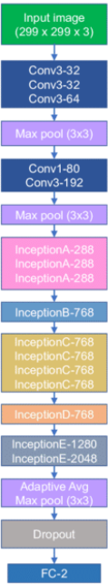
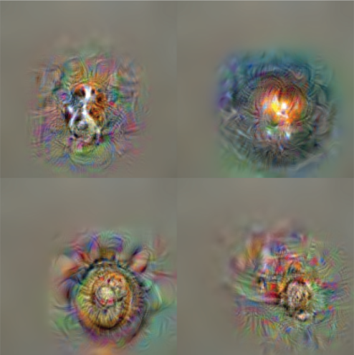
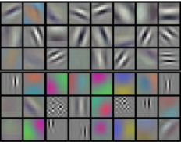
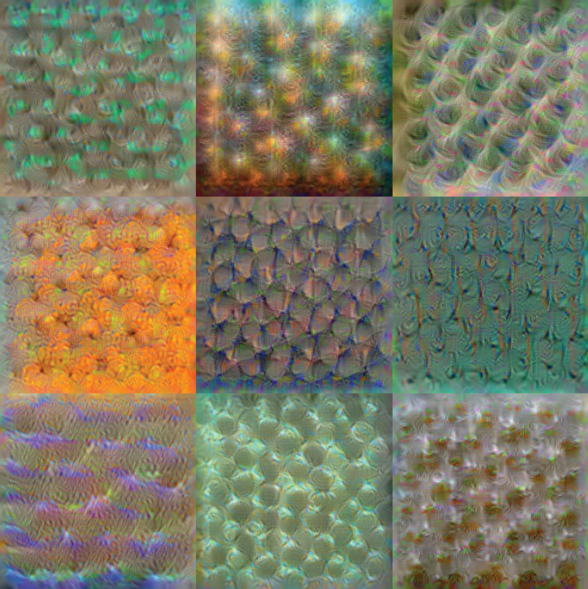
Inception v3 Network
Datasets
Prediction
Edge + blob
Texture
Object Parts
Source: http://vision03.csail.mit.edu/cnn_art/index.html
Source: https://www.researchgate.net/figure/CNN-architectures-of-a-Inception-v3-b-Inception-v4-c-Inception-ResNet-v2-d_fig3_345313795

Slide 37
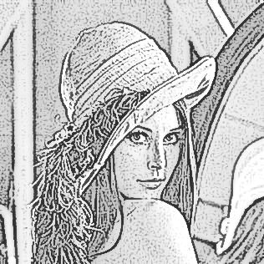
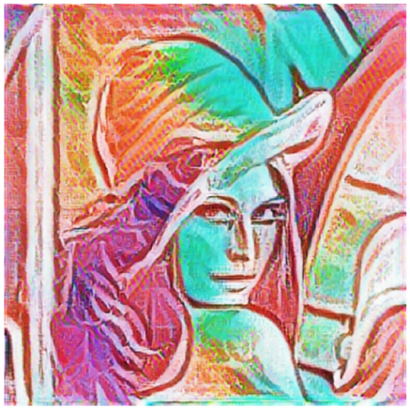
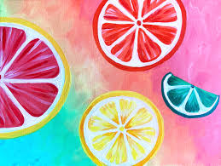
Introduction (Evaluation)
Calculate features for content image and style image.
Randomly generate new output image.
Calculate style loss and content loss of output image.
Use gradient descent to optimize output image.
GOTO step 2.
Content Image
Output Image
Trained Transfer Network
Trained Prediction Network
Style Image
Loss
Network

Slide 38
Build Environment
(Windows Version)

Slide 39
Build Environment
Python Version: 3.8.9
Create log, datasets, and checkpoints directory.
md log datasets\train datasets\val datasets\style checkpoints
Download and Unpack Pre-trained Networks.
Download VGG16 Pre-trained Network.
curl -o checkpoints\vgg_16_2016_08_28.tar.gz http://download.tensorflow.org/models/vgg_16_2016_08_28.tar.gz
Download Inception V3 Pre-trained Network.
curl -L "https://docs.google.com/uc?export=download&id=1H1X_dplTNwWXb2N_1Ji5HnqXKgj2cp2t" > checkpoints\Inception_v3_224.tgz
Unpack VGG16 Pre-trained Network.
tar zxvf checkpoints\vgg_16_2016_08_28.tar.gz –C checkpoints\
Unpack Inception V3 Pre-trained Network.
tar zxvf checkpoints\Inception_v3_224.tgz –C checkpoints\

Slide 40
Datasets Preprocessing
Download Datasets.
ImageNet Large Scale Visual Recognition Challenge 2012 (ILSVRC2012) train dataset.
curl -o datasets\ILSVRC2012_img_train.tar https://image-net.org/data/ILSVRC/2012/ILSVRC2012_img_train.tar
ImageNet Large Scale Visual Recognition Challenge 2012 (ILSVRC2012) validation dataset.
curl -o datasets\ILSVRC2012_img_val.tar https://image-net.org/data/ILSVRC/2012/ILSVRC2012_img_val.tar
Style datasets.
curl -L "https://docs.google.com/uc?export=download&id=1bK37Qx8jp2ax_ZPTGpc4iZvlb7tytwwa" > datasets/style/dtd_cobwebbed.tfrecord
Unpack Datasets.
tar xvf datasets\ILSVRC2012_img_train.tar –C datasets\train
cd train for %g in (*.tar) do tar xvf %g
tar xvf datasets\ILSVRC2012_img_val.tar –C datasets\val

Slide 41
Datasets Preprocessing (Cont’d)
After unpack all the datasets:
Should have 1,279,891 files in the train folder.
Should have 50,000 files in the val folder.

Slide 42
Install Requirements
pip install –r requirements.txt
requirements.txt
torchvision @ https://download.pytorch.org/whl/cu102/torchvision-0.10.0%2Bcu102-cp37-cp37m-linux_x86_64.whl torch @ https://download.pytorch.org/whl/cu102/torch-1.9.0%2Bcu102-cp37-cp37m-linux_x86_64.whl tensorflow @ file:///tensorflow-2.5.0-cp37-cp37m-linux_x86_64.whl tensorboard==2.5.0 keras==2.4.3 scipy==1.4.1 numpy==1.19.5 magenta==2.1.3 numba==0.48.0

Slide 43
Preprocess ImageNet Dataset (1/5)
Clone Tensorflow models repository to install slim module.
git clone https://github.com/tensorflow/models.git
Change directory to folder models.
cd models

Slide 44
Preprocess ImageNet Dataset (2/5)
Create file patch.txt
patch.txt
diff --git a/research/slim/datasets/build_imagenet_data.py b/research/slim/datasets/build_imagenet_data.pyindex 572bcd3..1669a49 100644--- a/research/slim/datasets/build_imagenet_data.py+++ b/research/slim/datasets/build_imagenet_data.py@@ -203,9 +203,9 @@ def _convert_to_example(filename, image_buffer, label, synset, human, bbox, [l.append(point) for l, point in zip([xmin, ymin, xmax, ymax], b)] # pylint: enable=expression-not-assigned - colorspace = 'RGB'+ colorspace = b'RGB' channels = 3- image_format = 'JPEG'+ image_format = b'JPEG' example = tf.train.Example(features=tf.train.Features(feature={ 'image/height': _int64_feature(height),@@ -213,15 +213,15 @@ def _convert_to_example(filename, image_buffer, label, synset, human, bbox, 'image/colorspace': _bytes_feature(colorspace), 'image/channels': _int64_feature(channels), 'image/class/label': _int64_feature(label),- 'image/class/synset': _bytes_feature(synset),- 'image/class/text': _bytes_feature(human),+ 'image/class/synset': _bytes_feature(synset.encode()),+ 'image/class/text': _bytes_feature(human.encode()), 'image/object/bbox/xmin': _float_feature(xmin), 'image/object/bbox/xmax': _float_feature(xmax), 'image/object/bbox/ymin': _float_feature(ymin), 'image/object/bbox/ymax': _float_feature(ymax), 'image/object/bbox/label': _int64_feature([label] * len(xmin)), 'image/format': _bytes_feature(image_format),- 'image/filename': _bytes_feature(os.path.basename(filename)),+ 'image/filename': _bytes_feature(os.path.basename(filename).encode()), 'image/encoded': _bytes_feature(image_buffer)})) return example @@ -314,7 +314,7 @@ def _process_image(filename, coder): width: integer, image width in pixels. """ # Read the image file.- image_data = tf.gfile.GFile(filename, 'r').read()+ image_data = tf.gfile.GFile(filename, 'rb').read() # Clean the dirty data. if _is_png(filename):@@ -525,7 +525,7 @@ def _find_image_files(data_dir, labels_file): # Shuffle the ordering of all image files in order to guarantee # random ordering of the images with respect to label in the # saved TFRecord files. Make the randomization repeatable.- shuffled_index = range(len(filenames))+ shuffled_index = list(range(len(filenames))) random.seed(12345) random.shuffle(shuffled_index)

Slide 45
Preprocess ImageNet Dataset (3/5)
Apply the patch.
git apply patch.txt
Change directory to folder slim.
cd models\research\slim
Install slim module.
python3 setup.py build python3 setup.py install

Slide 46
Preprocess ImageNet Dataset (4/5)
Preprocess ImageNet dataset. (4/5)
Change directory to folder slim/datasets.
cd datasets
Download ILSVRC2012 bounding boxes.
curl https://repository.prace-ri.eu/git/Data-Analytics/Benchmarks/-/raw/bfea8c2c69078a98c35a6e774809e7d9cc807874/ImageNetUseCaseV2/Dataset/Metadata/imagenet_2012_bounding_boxes.csv
Preprocess validation datasets.
python3 preprocess_imagenet_validation_data.py <VALIDATION_DATASET_DIRECTORY> imagenet_2012_validation_synset_labels.txt

Slide 47
Preprocess ImageNet Dataset (5/5)
Preprocess train datasets.
cd <TRAIN_DATASET_DIRECTORY> for i in *.JPEG do data_img=${i%%_*} img=${data_img} if [ ! -d $img ]; then mkdir $img fi mv $i $img done
Preprocess datasets.
python3 build_imagenet_data.py --train_directory=<TRAIN_DATASET_DIRECTORY> \ --validation_directory=<VALIDATION_DATASET_DIRECTORY> \ --output_directory=<OUTPUT_DIRECTORY> \
After preprocess ImageNet dataset :
Should have 1,152 files in the output folder.

Slide 48
Train and Evaluate the Model
Train the model, output trained model.
python3 train.py --imagenet_data_dir=<PREPROCESSED_DATASETS_DIRECTORY>
Convert the trained model, will output 2 models: predict.tflite and transfer.tflite.
python3 convert.py --imagenet_data_dir=<PREPROCESSED_DATASETS_DIRECTORY>
Evaluate the model.
python3 eval.py

Slide 49
Train
Import modules.
train.py
import ast import os from magenta.models.arbitrary_image_stylization import arbitrary_image_stylization_build_mobilenet_model as build_mobilenet_model from magenta.models.image_stylization import image_utils import tensorflow.compat.v1 as tf import tf_slim as slim

Slide 50
Define Directories
vgg_checkpoint = 'vgg16/vgg_16.ckpt' style_dataset_file = 'datasets/dtd_cobwebbed.tfrecord' inceptionv3_checkpoint = 'checkpoints/Inception_v3_224.ckpt' model_output = 'model_outputs'

Slide 51
Function to Process Input Images (1/2)
def main(unused_argv=None): tf.logging.set_verbosity(tf.logging.INFO) with tf.Graph().as_default(): # Let all input processing on the CPU, and training processing on the GPU. device = '/cpu:0' if not 0 else '/job:worker/cpu:0' with tf.device( tf.train.replica_device_setter(0, worker_device=device)): # Loads content images, batch size is 8, and content image size is 256*256 pixel. content_inputs_, _ = image_utils.imagenet_inputs(8, 256)

Slide 52
Function to Process Input Images (2/2)
# Loads style images. [style_inputs_, _, _] = image_utils.arbitrary_style_image_inputs( # Style dataset file. style_dataset_file, batch_size=8, image_size=256, # To shuffle style files at random. shuffle=True, # Crop the style image to 256*256 pixel. center_crop=False, # Resize the style images to a random size. augment_style_images=True, random_style_image_size=True)

Slide 53
Function to Define Content Weight and Style Weight
with tf.device(tf.train.replica_device_setter(0)): # Process content weight and style weight. content_weights = ast.literal_eval(default_content_weights) style_weights = ast.literal_eval(default_style_weights)

Slide 54
Function to Define the Model
stylized_images, total_loss, loss_dict, \ _ = build_mobilenet_model.build_mobilenet_model( # build content and style input tensor. content_inputs_, style_inputs_, # Set network parameters cannot be trained. mobilenet_trainable=False, # Set style and style transfer network parameters can be trained. style_params_trainable=True, transformer_trainable=True, # Set the endpoint to construct the style predict network. mobilenet_end_point='layer_19', # Reduce the number of filters in the model. transformer_alpha=0.25, style_prediction_bottleneck=100, # Add objectives to the model. adds_losses=True, content_weights=content_weights, style_weights=style_weights, total_variation_weight=1e4, )

Slide 55
Training Setup
# Adding scalar summaries to the tensorboard. for key, value in loss_dict.items(): tf.summary.scalar(key, value) # Adding Image summaries to the tensorboard. tf.summary.image('image/0_content_inputs', content_inputs_, 3) tf.summary.image('image/1_style_inputs_aug', style_inputs_, 3) tf.summary.image('image/2_stylized_images', stylized_images, 3)
# Set learning rate to 1e-5. optimizer = tf.train.AdamOptimizer(1e-5) # Define train optimizer. train_op = slim.learning.create_train_op( total_loss, optimizer, clip_gradient_norm=0, summarize_gradients=False)

Slide 56
Function to Load Checkpoints
# Function to load VGG16 parameters. init_fn_vgg = slim.assign_from_checkpoint_fn(os.path.expanduser(vgg_checkpoint), slim.get_variables('vgg_16')) # Function to load Inception V3 parameters. mobilenet_variables_dict = { var.op.name: var for var in slim.get_model_variables('MobilenetV2') } init_fn_mobilenet = slim.assign_from_checkpoint_fn( inceptionv3_checkpoint, mobilenet_variables_dict) # Function to restore VGG16 and Inception V3 parameters. def init_sub_networks(session): init_fn_vgg(session) init_fn_mobilenet(session)

Slide 57
Function to Build the Model
slim.learning.train( train_op=train_op, # Define log directory. logdir=os.path.expanduser(model_output), # Define address of the tensorflow master. master='', is_chief=0 == 0, # Define training steps. number_of_steps=800000, init_fn=init_sub_networks, # Save summaries every 15 seconds. save_summaries_secs=15, # Save model every 15 seconds. save_interval_secs=15)

Slide 58
Entry Point of the Code
def console_entry_point(): tf.disable_v2_behavior() tf.app.run(main) if __name__ == '__main__': console_entry_point()

Slide 59
Train (Cont’d)
Import modules.
convert.py
from __future__ import absolute_import from __future__ import division from __future__ import print_function import os import tempfile from magenta.models.arbitrary_image_stylization import arbitrary_image_stylization_build_mobilenet_model as build_mobilenet_model import numpy as np import tensorflow.compat.v1 as tf

Slide 60
Train (Cont’d)
Define directories.
saved_checkpoint_dir='model_outputs' outputs='tflite_output'
Function to load the checkpoint.
def load_checkpoint(sess, checkpoint): # Save the variables from checkpoint. model_saver = tf.train.Saver(tf.global_variables()) checkpoint = os.path.expanduser(checkpoint) # Define saved checkpoints directory. if tf.gfile.IsDirectory(checkpoint): checkpoint = tf.train.latest_checkpoint(checkpoint) model_saver.restore(sess, checkpoint)

Slide 61
Train (Cont’d)
Function to export the saved models. (1/6)
def export_to_saved_model(checkpoint, alpha): # Create a temporary directory. saved_model_dir = tempfile.mkdtemp() # Create a folder to save predict model. predict_saved_model_folder = os.path.join(saved_model_dir, 'predict') # Create a folder to save transfer model. transfer_saved_model_folder = os.path.join(saved_model_dir, 'transfer')

Slide 62
Train (Cont’d)
Function to export the saved models. (2/6)
with tf.Graph().as_default(), tf.Session() as sess: # Defines place holder for the style image. style_image_tensor = tf.placeholder( tf.float32, shape=[None, None, None, 3], name='style_image') # Defines place holder for the content image. content_image_tensor = tf.placeholder( tf.float32, shape=[None, None, None, 3], name='content_image')

Slide 63
Train (Cont’d)
Function to export the saved models. (3/6)
# Defines the model. stylized_images, _, _, bottleneck_feat = \ build_mobilenet_model.build_mobilenet_model( # Define content image and style image tensor. content_image_tensor, style_image_tensor, # Set parameters cannot be trained. mobilenet_trainable=False, style_params_trainable=False, transformer_trainable=False, # Set style prediction bottleneck. style_prediction_bottleneck=100, # Reduce the number of filters in the model. transformer_alpha=alpha, # Set the endpoint to construct the style predict network. mobilenet_end_point='layer_19', adds_losses=False)

Slide 64
Train (Cont’d)
Function to export the saved models. (4/6)
# Load model weights from the checkpoint. load_checkpoint(sess, checkpoint)
Function to export the saved models. (5/6)
# Save the train model. tf.saved_model.simple_save( sess, predict_saved_model_folder, inputs={style_image_tensor.name: style_image_tensor}, outputs={'style_bottleneck': bottleneck_feat})

Slide 65
Train (Cont’d)
Function to export the saved models. (6/6)
tf.saved_model.simple_save( sess, transfer_saved_model_folder, inputs={ content_image_tensor.name: content_image_tensor, 'style_bottleneck': bottleneck_feat }, outputs={'stylized_image': stylized_images}) return predict_saved_model_folder, transfer_saved_model_folder

Slide 66
Train (Cont’d)
Function to convert format of saved models. (1/2)
def convert_saved_model_to_tflite(saved_model_dir, input_shapes, float_tflite_file): # Converts a saved model into tflite format. converter = tf.lite.TFLiteConverter.from_saved_model( saved_model_dir=saved_model_dir, input_shapes=input_shapes) converter.optimizations = [tf.lite.Optimize.DEFAULT] tflite_float_model = converter.convert()
Function to convert format of saved models. (2/2)
# Write saved model with binary mode. with tf.gfile.GFile(float_tflite_file, 'wb') as f: f.write(tflite_float_model)

Slide 67
Train (Cont’d)
Function to generate parse function for training dataset, to resize the image size.
def parse_function(image_size, raw_image_key_name): def func(example_proto): # Parses example protos into a dict of tensors. image_raw = tf.io.parse_single_example( example_proto, features={raw_image_key_name: tf.FixedLenFeature([], tf.string)}, ) # Decode a JPEG-encoded image to a uint8 tensor. image = tf.image.decode_jpeg(image_raw[raw_image_key_name]) # Expand image tensor at axis 1. image = tf.expand_dims(image, axis=0) # Resize image to 256*256 pixels. image = tf.image.resize_bilinear(image, (image_size, image_size)) # Removes dimensions of size 1 from the shape of image tensor. image = tf.squeeze(image, axis=0) image = image / 255.0 return image return func

Slide 68
Train (Cont’d)
Function to filtered non-RGB images.
def rgb_filter_function(image): shape = tf.shape(image)[2] return tf.math.equal(shape, 3)

Slide 69
Train (Cont’d)
Files and paths setup.
def main(unused_argv=None): # Load model weights from trained checkpoint and export to saved model format. predict_saved_model_folder, \ transfer_saved_model_folder = export_to_saved_model( os.path.expanduser(saved_checkpoint_dir), 0.25) # Define the output saved models directory. output_dir = os.path.expanduser(outputs) if tf.io.gfile.isdir(output_dir): tf.logging.warn('Folder already existed.') else: os.mkdir(output_dir)

Slide 70
Train (Cont’d)
Convert from saved model to TensorFlow Lite format.
predict_float_tflite_file = os.path.join(output_dir, 'style_predict.tflite') transfer_float_tflite_file = os.path.join(output_dir, 'style_transfer.tflite')

Slide 71
Train (Cont’d)
Function to convert the saved predict model to float32.
convert_saved_model_to_tflite( saved_model_dir=predict_saved_model_folder, input_shapes={ # Set the style image size to 384*384 pixels. 'style_image': [None, 384, 384, 3] }, float_tflite_file=predict_float_tflite_file)
Function to convert the saved transfer model to float32.
convert_saved_model_to_tflite( saved_model_dir=transfer_saved_model_folder, input_shapes={ # Set the content image size to 384*384 pixels. 'content_image': [None, 384, 384, 3] }, float_tflite_file=transfer_float_tflite_file)

Slide 72
Train (Cont’d)
Entry point.
def console_entry_point(): tf.disable_v2_behavior() tf.app.run(main) if __name__ == '__main__': console_entry_point()

Slide 73
Evaluation
Import modules.
eval.py
import IPython.display as display import numpy as np import functools import time import cv2 from google.colab.patches import cv2_imshow import matplotlib.pyplot as plt import matplotlib as mpl mpl.rcParams['figure.figsize'] = (12,12) mpl.rcParams['axes.grid'] = False

Slide 74
Evaluation (Cont’d)
Import content image and style image, preprocess the content image.
url = 'https://i.imgur.com/tDm3fB1.png' r = requests.get(url, allow_redirects=True) open('content.png', 'wb').write(r.content) gray = cv2.imread("content.png", 0) sobelX = cv2.Sobel(gray, cv2.CV_64F, 1, 0) sobelY = cv2.Sobel(gray, cv2.CV_64F, 0, 1) sobelX = np.uint8(np.absolute(sobelX)) sobelY = np.uint8(np.absolute(sobelY)) sobelCombined = cv2.bitwise_or(sobelX, sobelY) dst = cv2.addWeighted(~sobelCombined,.5,gray,.3,50) cv2.imwrite("content.png",dst)
style_path = tf.keras.utils.get_file('style.jpg','https://skyeprattcom.files.wordpress.com/2020/06/simple-summer-citrus-1-1.jpg')

Slide 75
Evaluation (Cont’d)
Function to load an image, and add a batch dimension.
def load_img(path_to_img): # Load import image. img = tf.io.read_file(path_to_img) # Decode image from array to RGB image. img = tf.io.decode_img(img, channels=3) # Make the value of the image represented by the floating point in range [0,1). img = tf.img.convert_img_dtype(img, tf.float32) # Add new axis to image. img = img[tf.newaxis, :] return img

Slide 76
Evaluation (Cont’d)
Function to resize the image dimension becomes 256 pixels.
def resize_img(img, target_dim): # Change the image representation from int32 to float32. shape = tf.cast(tf.shape(img)[1:-1], tf.float32) # Define shorter side of image. short_dim = min(shape) # Calculate the increase scale. scale = target_dim / short_dim # Change the image representation from float32 to int32. new_shape = tf.cast(shape * scale, tf.int32) # Resize the image so that the shorter side becomes 384 pixel. img = tf.img.resize(img, new_shape) # Cropping or Padding the image. img = tf.img.resize_with_crop_or_pad(img, target_dim, target_dim) return img

Slide 77
Evaluation (Cont’d)
Load the input images, and resizing input images.
# Load content image. content_img = load_img(content_path) # Load style image. style_img = load_img(style_path) # resize the content image to 384 pixel. resized_content_img = resize_img(content_img, 384) # resize the style image to 384 pixel. resized_style_img = resize_img(style_img, 384)

Slide 78
Evaluation (Cont’d)
Function to visualize the images.
def imshow(img): # Remove the image dimension that equal 1. img = tf.squeeze(img, axis=0) plt.imshow(img)

Slide 79
Evaluation (Cont’d)
Function to predict style image.
def run_style_predict(resized_style_img): # Import the predict model. interpreter = tf.lite.Interpreter(model_path="predict.tflite") interpreter.allocate_tensors() # Set model predict input. input_details = interpreter.get_input_details() interpreter.set_tensor(input_details[0]["index"], resized_style_img) # Set network bottleneck. interpreter.invoke() style_bottleneck = interpreter.tensor( interpreter.get_output_details()[0]["index"] )() return style_bottleneck

Slide 80
Evaluation (Cont’d)
Function to transfer image.
def run_style_transfer(style_bottleneck, resized_content_img): # Import the trained transfer model. interpreter = tf.lite.Interpreter(model_path="transfer.tflite") # Set model transfer input. input_details = interpreter.get_input_details() interpreter.allocate_tensors() # Set model transfer inputs. interpreter.set_tensor(input_details[0]["index"], resized_content_img) interpreter.set_tensor(input_details[1]["index"], style_bottleneck) interpreter.invoke() # transfer content image. stylized_img = interpreter.tensor( interpreter.get_output_details()[0]["index"] )() return stylized_img

Slide 81
Evaluation (Cont’d)
Generate output image.
stylized_img = run_style_transfer(style_bottleneck, resized_content_img)
Visualize output image.
imshow(stylized_img) plt.axis('off')

Slide 82
Evaluation (Cont’d)
Use bottleneck to resize content image from 384 to 256 pixel.
content_bottleneck = run_style_predict( resize_image(content_image, 384) )
Modify content weight.
# Define content weight between 0 to 1. content_weight = 0.1 # Blend output image and content image Blended_image = content_weight * content_bottleneck \ + (1 - content_weight) * style_bottleneck # Transfer blended image. Blended_stylized_image = run_style_transfer(blended_image,resized_content_image) # Visualize output image. imshow(Blended_stylized_image) plt.axis('off')

Slide 83
Examples

Slide 84

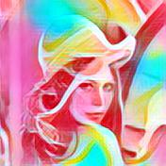
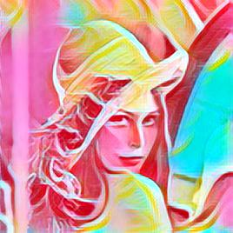
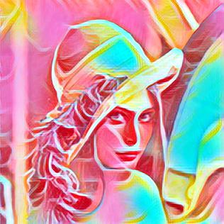
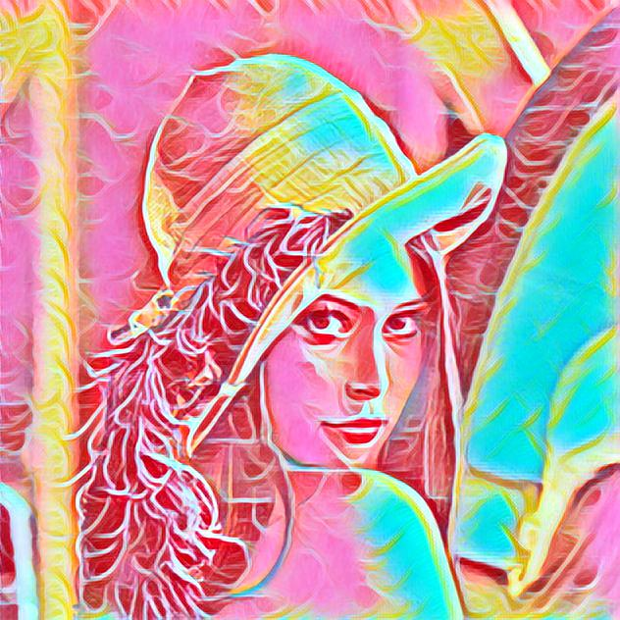
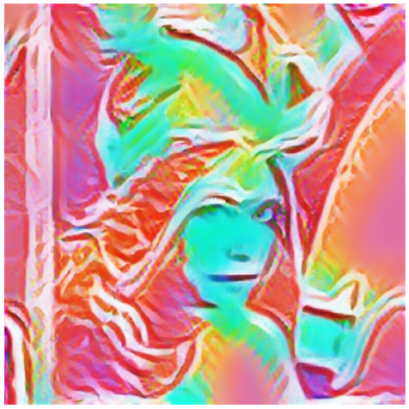
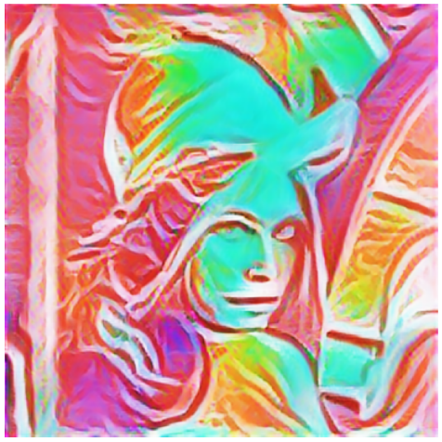
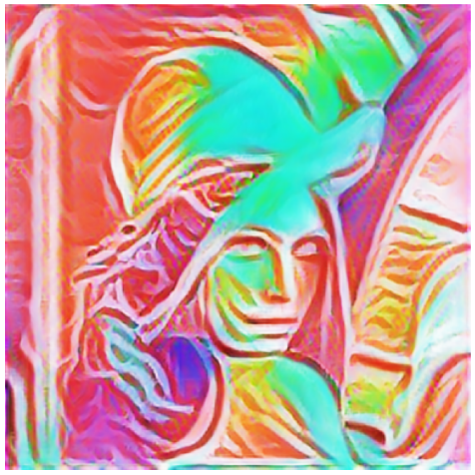

Example 1
Style
Content Weight
0.1 0.4 0.7 1
Input
Fei-Fei Li’s
Ours

Slide 85
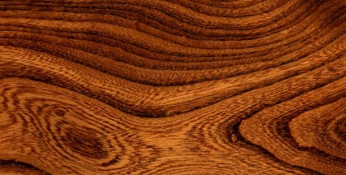
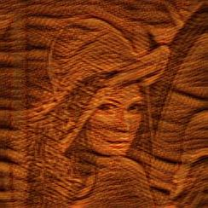
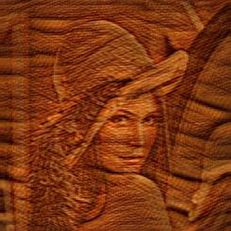
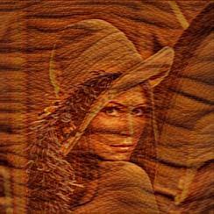
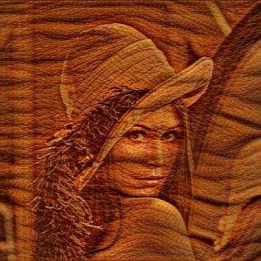
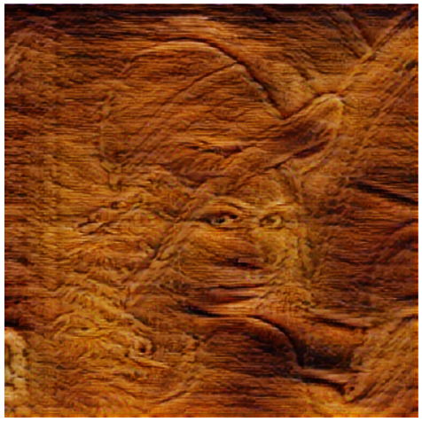
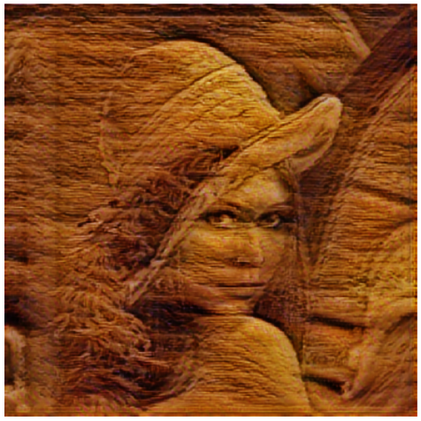
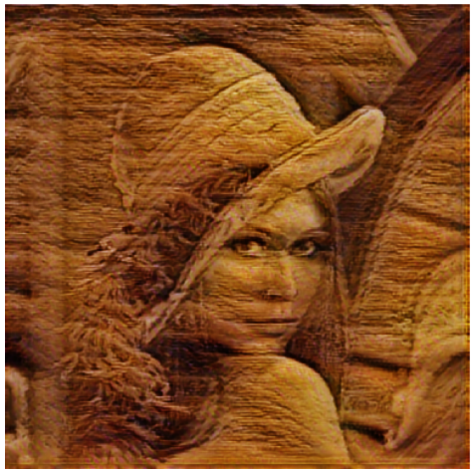
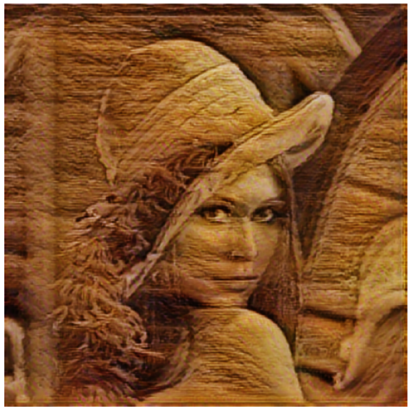
Example 2
Style
Content Weight
0.1 0.4 0.7 1
Input
Fei-Fei Li’s
Ours

Slide 86
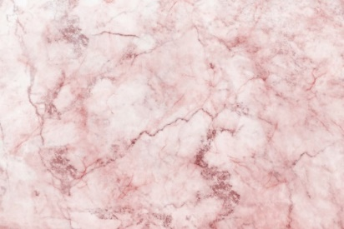
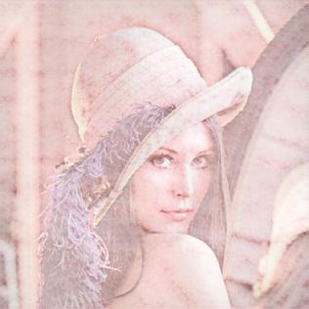
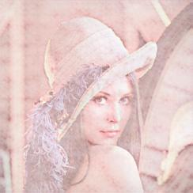
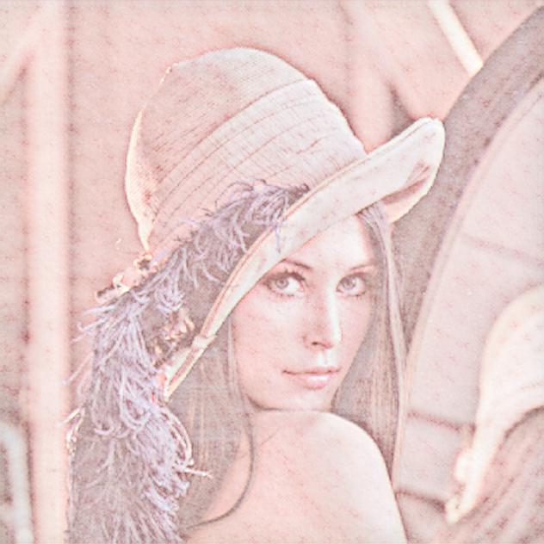
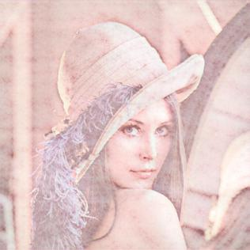
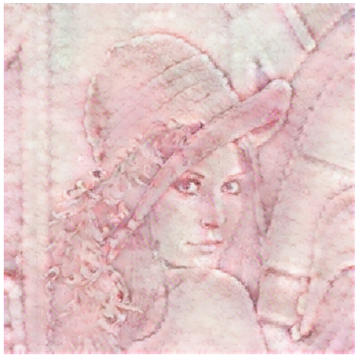
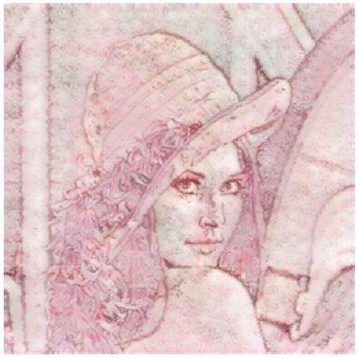
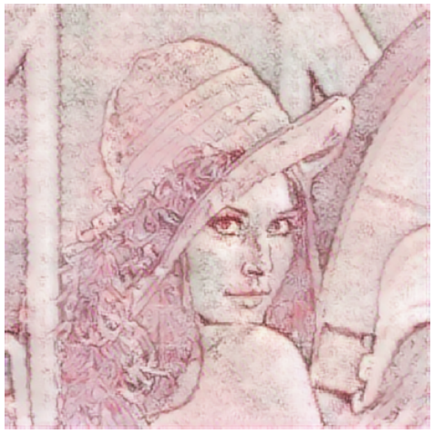
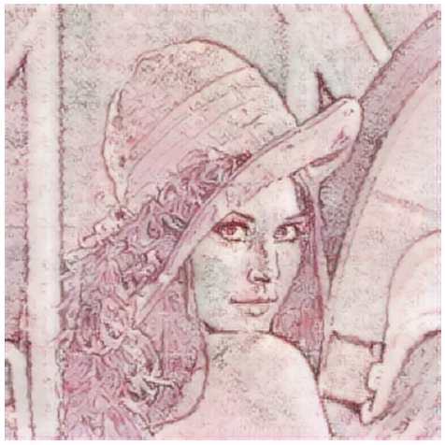
Example 3
Style
Content Weight
0.1 0.4 0.7 1
Input
Fei-Fei Li’s
Ours

Slide 87

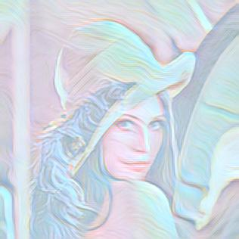
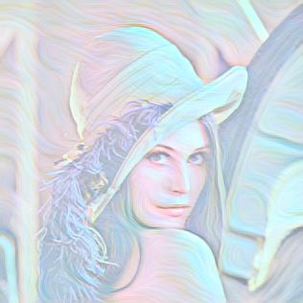
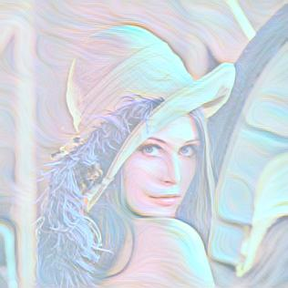
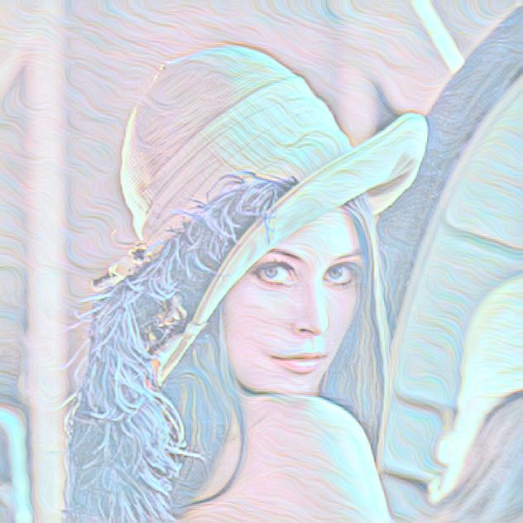
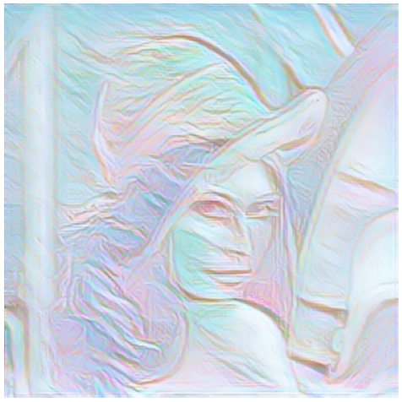
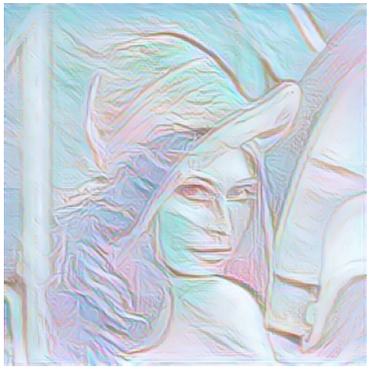
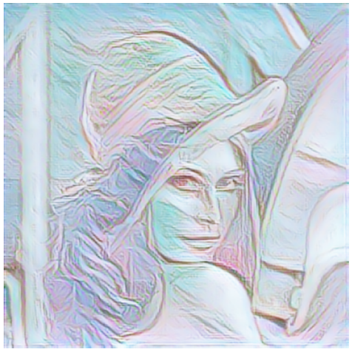
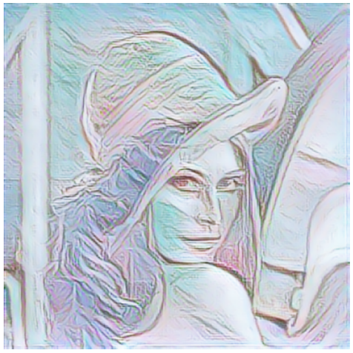
Example 4
Style
Content Weight
0.1 0.4 0.7 1
Input
Fei-Fei Li’s
Ours

Slide 88
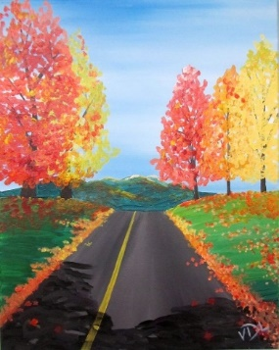
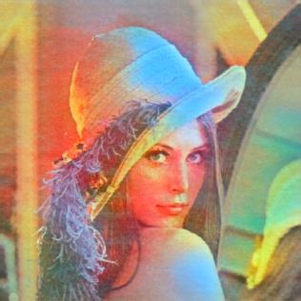
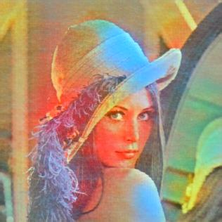






Example 5
Style
Content Weight
0.1 0.4 0.7 1
Input
Fei-Fei Li’s
Ours

Slide 89









Example 6
Style
Content Weight
0.1 0.4 0.7 1
Input
Fei-Fei Li’s
Ours

Slide 90









Example 7
Style
Content Weight
0.1 0.4 0.7 1
Input
Fei-Fei Li’s
Ours

Slide 91









Example 8
Style
Content Weight
0.1 0.4 0.7 1
Input
Fei-Fei Li’s
Ours

Slide 92









Example 9
Style
Content Weight
0.1 0.4 0.7 1
Input
Fei-Fei Li’s
Ours

Slide 93









Example 10
Style
Content Weight
0.1 0.4 0.7 1
Input
Fei-Fei Li’s
Ours

Slide 94










Example 11
Style
Content Weight
0.1 0.4 0.7 1
Input
Fei-Fei Li’s
Ours

Slide 95










Example 12
Style
Content Weight
0.1 0.4 0.7 1
Input
Fei-Fei Li’s
Ours

Slide 96










Example 13
Style
Content Weight
0.1 0.4 0.7 1
Input
Fei-Fei Li’s
Ours

Slide 97








Example 14
Style
Content Weight
0.1 0.4 0.7 1
Input
Fei-Fei Li’s
Ours

Slide 98








Example 15
Style
Content Weight
0.1 0.4 0.7 1
Input
Fei-Fei Li’s
Ours

Slide 99








Example 16
Style
Content Weight
0.1 0.4 0.7 1
Input
Fei-Fei Li’s
Ours

Slide 100









Example 17
Style
Content Weight
0.1 0.4 0.7 1
Input
Fei-Fei Li’s
Ours

Slide 101








Example 18
Style
Content Weight
0.1 0.4 0.7 1
Input
Fei-Fei Li’s
Ours

Slide 102








Example 19
Style
Content Weight
0.1 0.4 0.7 1
Input
Fei-Fei Li’s
Ours

Slide 103








Example 20
Style
Content Weight
0.1 0.4 0.7 1
Input
Fei-Fei Li’s
Ours

Slide 104








Example 21
Style
Content Weight
0.1 0.4 0.7 1
Input
Fei-Fei Li’s
Ours

Slide 105








Example 22
Style
Content Weight
0.1 0.4 0.7 1
Input
Fei-Fei Li’s
Ours

Slide 106









Example 23
Style
Content Weight
0.1 0.4 0.7 1
Input
Fei-Fei Li’s
Ours

Slide 107








Example 24
Style
Content Weight
0.1 0.4 0.7 1
Input
Fei-Fei Li’s
Ours

Slide 108








Example 25
Style
Content Weight
0.1 0.4 0.7 1
Input
Fei-Fei Li’s
Ours

Slide 109








Example 26
Style
Content Weight
0.1 0.4 0.7 1
Input
Fei-Fei Li’s
Ours

Slide 110








Example 27
Style
Content Weight
0.1 0.4 0.7 1
Input
Fei-Fei Li’s
Ours

Slide 111








Example 28
Style
Content Weight
0.1 0.4 0.7 1
Input
Fei-Fei Li’s
Ours

Slide 112
References
https://arxiv.org/pdf/1603.08155.pdf
https://upload.wikimedia.org/wikipedia/zh/3/34/Lenna.jpg
http://1.bp.blogspot.com/-qjEiZMIFSPM/Uq09aPXKLPI/AAAAAAAAALw/CNom8SFrINQ/s1600/avril_lavigne_goodbye_lullaby-wallpaper-3554x1999.jpg
https://cdn.pixabay.com/photo/2014/02/17/10/20/statue-of-liberty-267948__480.jpg
https://paulryan.com.au/wp-content/uploads/2015/01/high-resolution-wallpapers-25.jpg
https://www.easypeasyandfun.com/wp-content/uploads/2018/06/Acrylic-Painting-for-Beginners.jpg
https://www.greenorc.com/2019/12/easy-acrylic-abstract-painting-ideas/
https://www.istockphoto.com/vector/abstract-marble-swirls-background-gm1153304885-313186472

